Slide 1

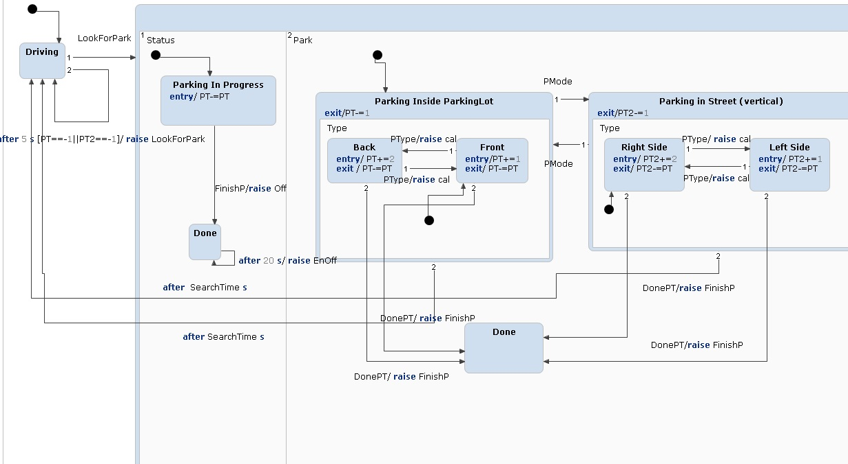
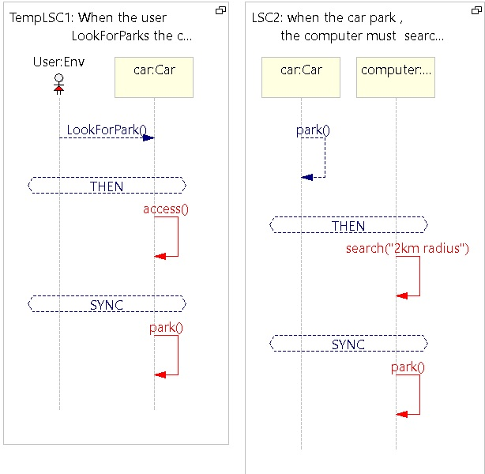
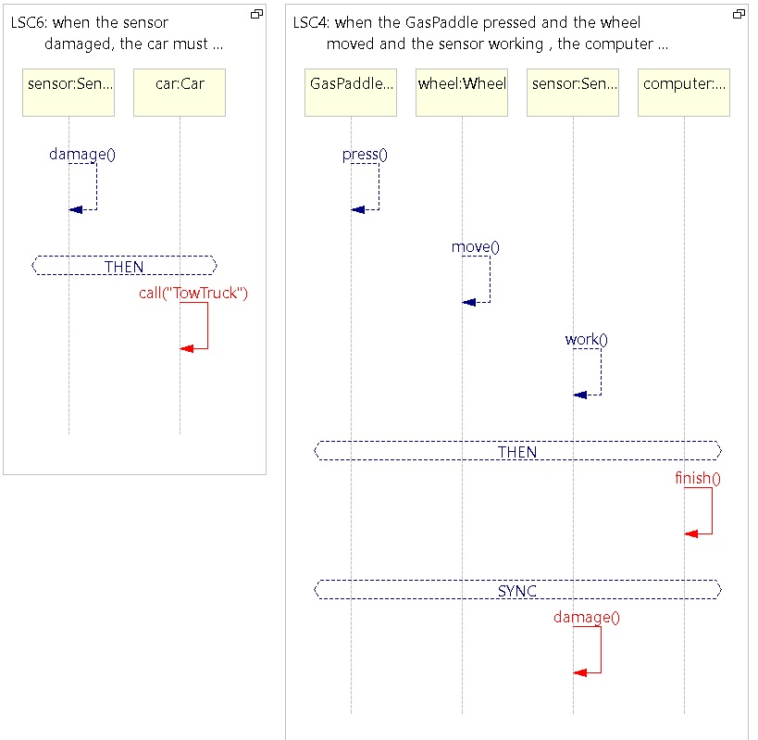
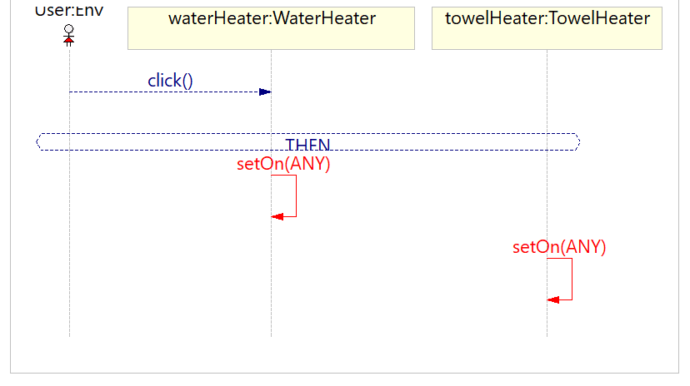
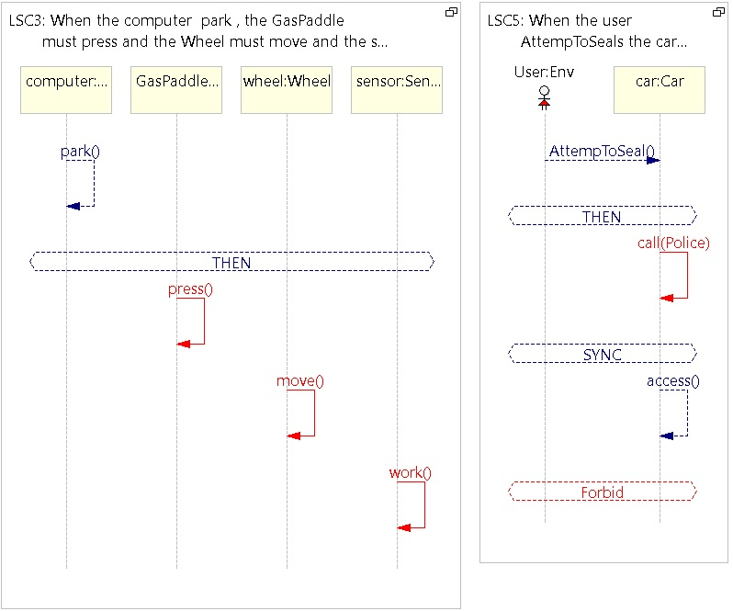
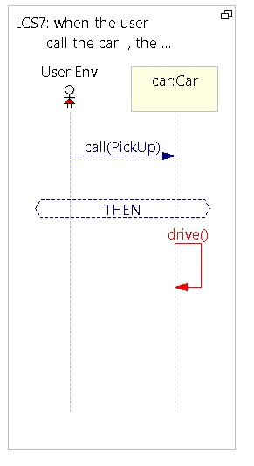
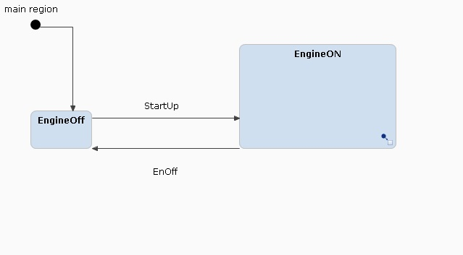
Visual programming for reactive systems | Autonomous car Vitali Bucevich 319275541 Yarin Barom 204607519
Dr. Michal Gordon
Overview
Project purpose
Creating a new reactive system in visual languages, modeling and running parts of the system.
Project Title
Autonomous car
Introduction
Autonomous car is a vehicle that is capable of sensing its environment and moving safely with little or no human input.
All the program have been written using visual programming language (VPL) so the developer can write a program using visual elements instead of code lines.
Reactive examples in the system
The system is directed by the sensors and the driver choice.
For example, when the driver want to park in a park lot. He choose the parking mode and the sensors scan the park lot to find a free parking.
According to those inputs the car park.
State-Charts
LSCs
Conclusions
This project was very interesting for us, we learn more about autonomous car and its abilities.
Visual programming language is more intuitive, and that made the learning about the abilities of autonomous car more easy.
After learning in this course we wish all courses will be teaching in this way.

